Slide 2
Action Is Urgently Needed
Bees are critically endangered. They are a key contributor to the pollination of our crops, but sadly, 33% of Irish bees are facing extinction.
Bees are an indicator for biodiversity in general and once a species is extinct this cannot be reversed.
The balance of nature is affected forever.

Slide 3
What is DCs for Bees?
DCs for Bees, is a sub initiative of Host in Ireland, that aims to bring an industry together in a way that has never been done before.
Host In Ireland and its data centre industry partners are uniting to make a difference by pledging to deliver on actions to make Ireland more pollinator friendly and ensure the survival of our pollinators for future generations.

Slide 4
Ambassador Community
Pollinator Plan
Orchards Initiative
Difference Days
1
2
3
4

Slide 5
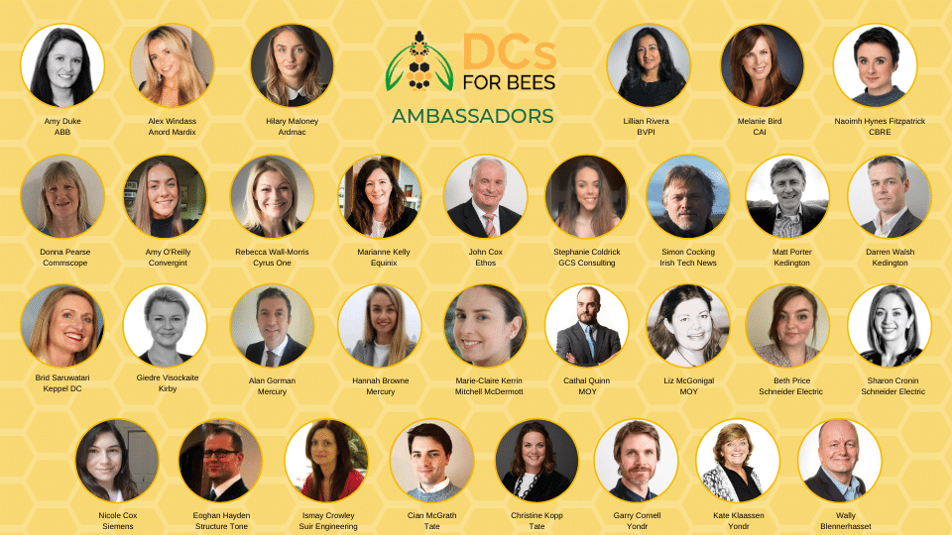
DCs for Bees Ambassadors
Are a key part of DCs for Bees program
Exist to advocate, create awareness and take action through their organisations, colleagues, communities, families and friends
Have a genuine interest in the environment, biodiversity, bees and are enthused to make a difference

Slide 6
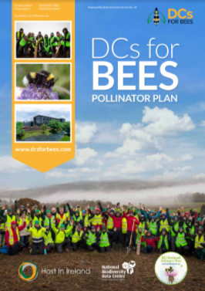
Data Centre Pollinator Plan
Uniting to make a difference
A blueprint to help our partners (and beyond) take long term action on the decline of bees and make a bigger impact
Outlines greatest impact actions that can be taken by companies and useful resources
Designed in partnership with National Biodiversity Data Centre and DCs for Bees Ambassador group
2019 -
2020 -
Mar ‘21
Apr ‘21
HII start partnership with National Biodiversity Data Centre
DCs for Bees Ambassadors input to pollinator plan development
Senior Mgrs (from partner companies) pledge support to pollinator plan
Public Launch of Pollinator Plan
Ongoing pollinator-friendly actions by partner companies
Awareness training
Orchards
Difference day

Slide 7
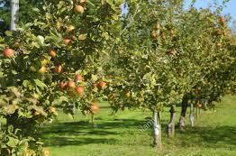
The Orchards Initiative
One of the actions to help pollinators is to plant variety orchard trees.
Host in Ireland has organised to purchase 1,000 mixed fruit Orchards.
These will be planted by our partners, their staff & their communities during the dormant season (Nov – March ) and will facilitate positive action within partner companies, employee base and activate their communities.
The project will also facilitate a much broader reach than the industry directly

Slide 8
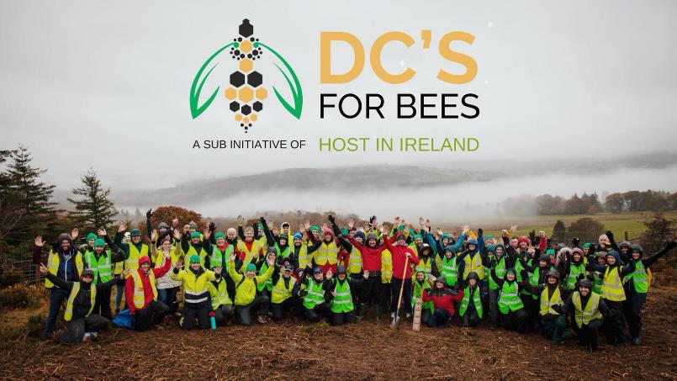
Difference Days
Host in Ireland creates opportunities for our partners to create a lasting impactful difference to Ireland’s biodiversity.
Our first Difference Day was in 2019.
100 people from the data centre industry came together alongside the Native Woodland Trust to change a part of our landscape for better.
100 people planted 2,000 trees covering two acres.

Slide 9
Proposed Timeline
21 April
Public launch of DCs for Bees Pollinator Plan
21 April
Public webinar: ‘Data centres & biodiversity’
17 June
Public launch of Orchards initiative
Difference Day #1 (Virtual)
Difference Day #2
Mar ‘21
April ‘21
May ‘21
Jun ‘21
Nov ‘21
Feb ‘22
11 March
Present to HII Councils
20 May
WORLD BEE DAY
Public webinar: ‘Do Something Small’
Orchards dispatch & planting
27 April
Partner webinar: ‘Do Something Small’

