Slide 1
Wally Blennerhassett, John Cox, Nicole Cox
Notes:
Wally
Wally
Welcome to our Host in Ireland presentation entitled Bee the Difference.
Over the next half hour or so we plan to talk to you about our pollinators, the vital work that they do for mankind, and the uncertain future that they face which presents us humans with a major problem. We will talk about what we can all do to reverse and fix this problem and point you at the best places to find the information you will need to help.
The problem that our pollinators face is a Major Global Problem. Unfortunately, if you are like me and you hear the words Major Global Problem, you probably feel pretty helpless. I know I do. I feel that anything that I do will be so insignificant that it will make no difference.
Our objective today is to show you that we can all do something and that can make a difference no matter what our circumstances are or where you live. Many things that we will discuss are very easy and often mean doing nothing at all (which is often the kind of actions that I like). With many major issues it is often not the big gestures but small actions from many people that can make the difference. An analogy I often use when talking to people is provided by our Honey bees themselves. One honey bee in its whole life can produce just a 1/12 of a teaspoon of honey. One Bee Hive in a season can produce 60 lbs of honey. Little actions by many when joined together can have huge results. So if we all do something small, the result can be enormous.
--

Slide 2
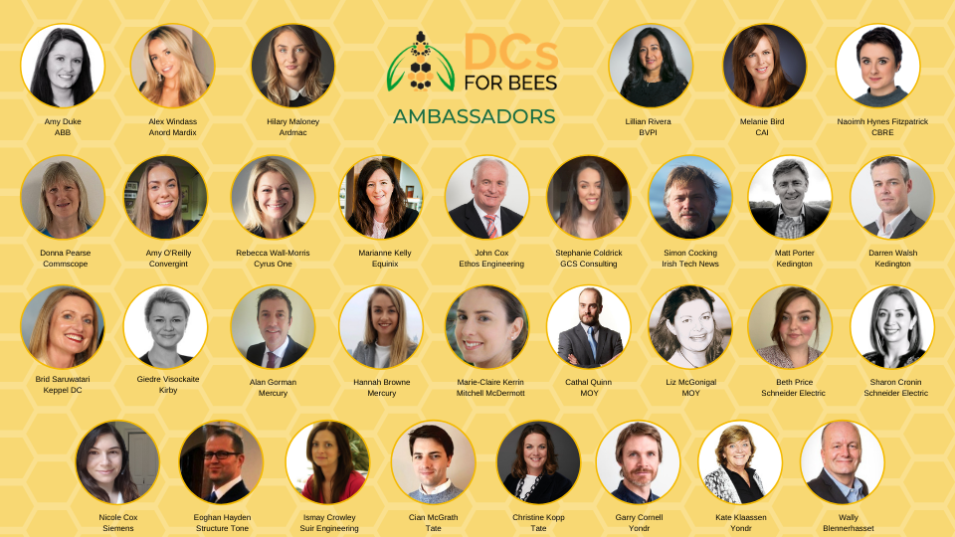

Slide 3
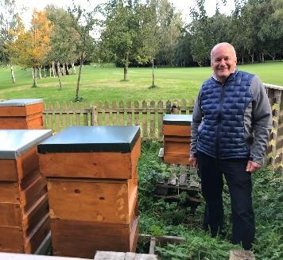
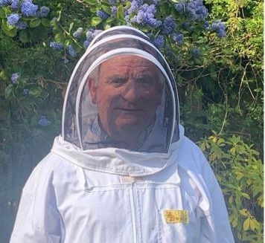
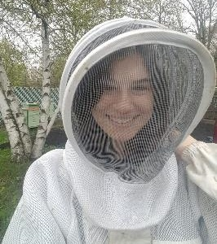
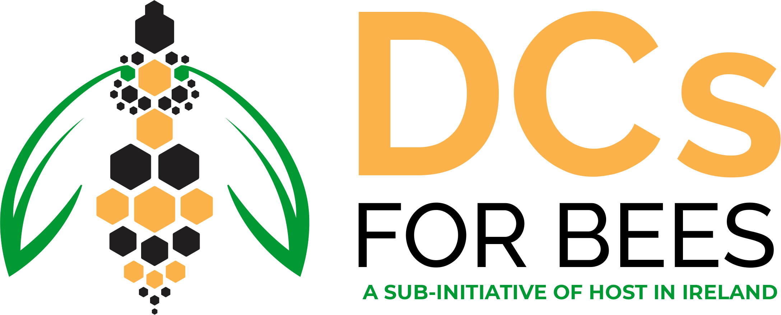
Introductions
Wally Blennerhassett
DCs for Bees Ambassador
Beekeeper (4 years)
Bee Enthusiast (forever)
Dublin
John Cox
DC for Bees Ambassador on
behalf of Ethos Engineering
Beekeeper (30 years)
Wicklow
Nicole Cox
DCs for Bees Ambassador on behalf of Siemens Ireland
Volunteer Beekeeper (4 years)
Texas → Boston → Dublin

Slide 4
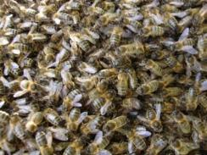
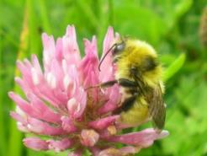
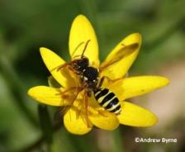
Bees in Ireland
Ireland has 99 bee species:
Honeybee
Bumblebees
Solitary bees
1
21
77
WILD POLLINATORS
Notes:
I think that most people would feel that they have a fair idea of the different types of bees we have. We have Honey Bees and Bumble Bees right?
In Ireland we have one species of Honey bee but what many people don’t know is that we have 21 different species of Bumblebee and in addition 77 different types of solitary bee. So next time you hear a bee buzzing around it remember it could be any one of 99 different bee species.
•Honeybee and bumblebee live in colonies made up of one Queen, who lays all the eggs, the Workers, and the Drones.
•Probably no surprise to at least half of you, all worker bees are female and they raise the young, gather the food and clean the hive and in general do all the work.
•Male bees are called drones and their incredibly demanding purpose in life is to mate with the Queen.
•All Bees, whether Honey, Bumble or Solitary, as they collect food traveling from flower to flower perform an essential service to mankind in that they pollinate plants as they transfer pollen from one plant to another.

Slide 5
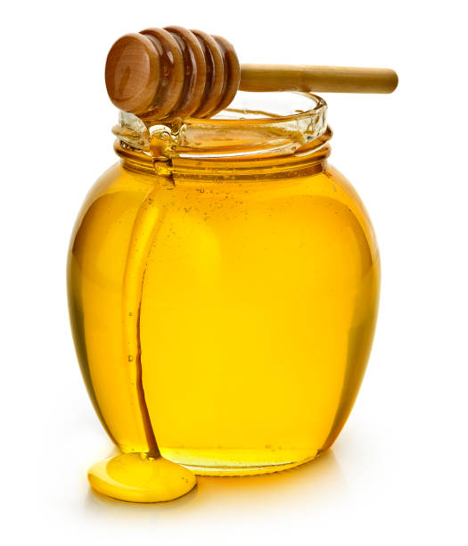
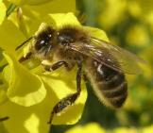
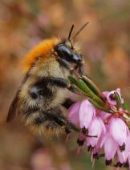
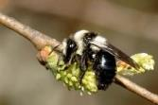
Why we Need Honeybees & Pollinators
To ensure pollination of Irish crops and wild plants
One of our busiest work-forces
€59 million annual value to Ireland
Honey!
>
>
>
>
Notes:
So let me talk a little bit about the Honey bee and what it is that makes native Irish honey bee so important?
We know we get Honey and the many benefits that that can bring.
More importantly, Honey bees are very efficient at pollinating our crops and plants. In a single hive you could have 60,000 bees so as you can imagine as they gather their food they can pollinate an awful lot of plants.
It is estimated that pollination carried out by bees is worth at 59 million euro annually to the Irish economy.

Slide 6
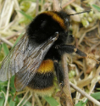
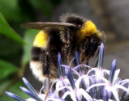
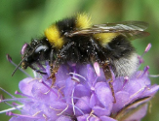
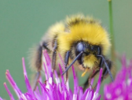
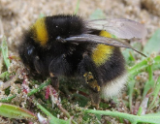
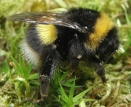
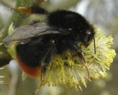
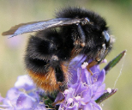
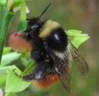
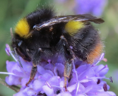
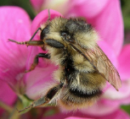
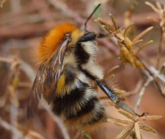
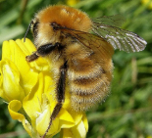
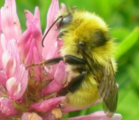
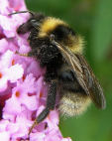
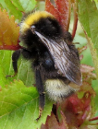
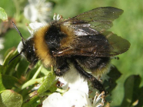
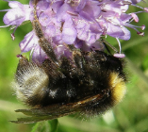
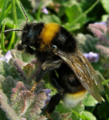
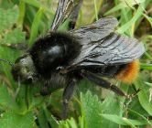
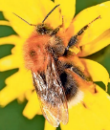
Bumblebees– 21 Different Types in Ireland
Notes:
21 species, of which six are threatened with extinction from Ireland. An additional 3 species are near threatened.
Like the honeybee, bumblebees are social bees. They live in colonies with a queen, many female workers, and some males.
Ireland has 21 native bumblebee species. Of these, 6 species are cuckoo bumblebees which are kleptoparasites in that they steal food and resources already procured by another bees. These cuckoo species don’t make their own nests, but instead lay their eggs in the nest of a true bumblebee who will inadvertently bring up their young.
As with all bees, only the females can sting! Female bumblebees can sting more than once. Bumblebees are not at all aggressive and are interested only in collecting pollen and nectar.
Those of you who are Harry Potter followers might be interested to know that The Old English name for Bumblebee is Dumbledore

Slide 7
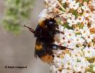
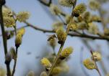
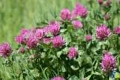
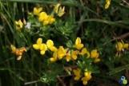
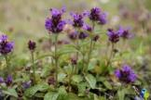
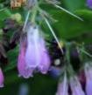
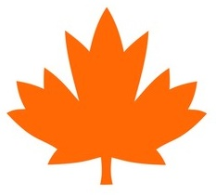
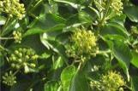
Need Food Sources Throughout the Year
EARLY SPRING:
Queens are establishing nests
Queens may visit 6000 flowers a day
SPRING – SUMMER: nests are growing, workers are active
AUTUMN:
Queens are fattening up ready for hibernation
Notes:
In the Spring a Bumblebee queen emerges from hibernation. food. The queen may need to visit up to 6000 flowers a day to get sufficient nectar just to generate enough heat to brood her eggs. After the eggs hatch and the nest develops Bumble bees require huge areas to forage for food. In Autumn/Winter all Bumblebees other than the Queen die, the queen then hibernates. In order to hibernate the Queen requires vast amounts of food to build up her fat levels and to survive the winter and emerge in the Spring and start the process all over again.

Slide 8
Solitary Bees – 77 Different Types in Ireland
Notes:
The majority of solitary species are mining bees who make their home in the ground. A smaller percentage take refuge in walls, wooden structures, and bee hotels

Slide 9
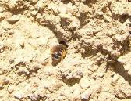
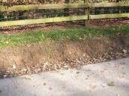
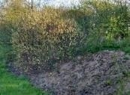
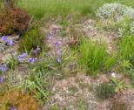
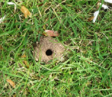
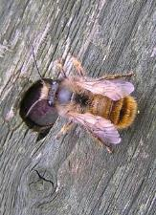
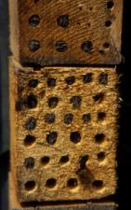
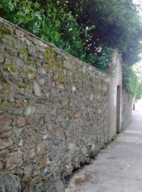
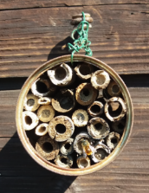
Where Do Solitary Bees Nest?
62
Nest in earth
MINING BEES
species
15
Nest in walls & structures
CAVITY NESTING BEES
species
John O’Boyle
Notes:
Mention the impact things like rewilding and the dandelions

Slide 10
Are Pollinators Declining in Ireland?
Notes:
Now some of the bad news. We mentioned we have 99 species of Bee in Ireland. Our bees and bee numbers have been monitored since 1980. Since then we have seen huge declines. In fact it has been described as being in freefall.
6 species, are at critical levels, 10 in a dangerous situation, and 14 further species are just about hanging in there. We have lost 2 species. So two species that no longer exist in Ireland.
If we remember that these bees pollinate our plants that produce much of our food you can see how serious this is.

Slide 11
Why are Pollinators Declining?
>
Habitat loss: HOMELESSNESS
General decline in wildflowers: HUNGER
Pests and diseases: SICKNESS
Pesticides: POISONING
Climate change: CHANGING ENVIRONMENT
>
>
>
>
Notes:
So why is this happening.
The places that wild bees live are disappearing. As we continue to cover our planet with concrete, more roads, more buildings, farm in more intensive ways and manicure our parks, green spaces and gardens their Habitat, the places they live are disappearing.
In the same way the places that grow their food is disappearing. Bees need food throughout the season so vitally important that we have a range of plants that bloom when the bees need them. So we need a diverse range of plants.
Different diseases are attacking our bees. There are many, probably the most dangerous attacking our honey bees, the Varroa Mite which has spread from the Continent and decimates hives.
The use of pesticides, Bees are insects, pesticides kill insects.
Climate change effects everything including our bees. Flowers blooming at different times that may not be at the time that the bees need the food.

Slide 12
Food, Shelter & Safety for pollinators
Bumblebees (21 species)
Mining solitary bees (62 species)
Cavity nesting solitary bees (15 species)
Bare ground, south/east facing banks
Hollow stems, holes in wood, bee nest boxes
Long grass, base of hedgerow
Eliminate or reduce the use of pesticides
Notes:
When we’re looking at the ways we can help bees, it’s important to keep in mind that their needs are not so different from our own. As with any species, they look for food, shelter, and safety. Food is important throughout the year, but particularly important between the Spring and Autumn. In a few slides, we’ll be discussing some resources available in the All Ireland Pollinator Plan which provide seasonal gardening tips. In terms of shelter, there are many things we all can do, from growing out the hedgerows as Wally mentioned, to changing our priorities when maintaining the home gardens. Rather than needing everything to be perfectly manicured, we can help provide shelter by looking instead to find beauty in natural life. Instead of working to make things pristine, we can focus instead on whether they are healthy and helpful to our pollinators.
As for safety, eliminating pesticides really is Number One and if we can all do our part there, we’ll be making a real difference.
Stay away from imported bee bombs ** note on the pesticides

Slide 13
Areas we can influence
>
Small differences in our daily Life
Where we work
Community areas
Sports Grounds
Gardens + Fruit Trees
Balconies
>
>
>
>
>
Notes:
Next, we’ll discuss the variety of ways that we can use our voices to tackle the larger threats pollinators face and speak up for the bees in our local communities. In addition to alternatives to pesticide and growing seasonal pollinator-friendly plants, we can also make small but impactful changes in our daily lives to help native bees. It’s important to keep in mind while shopping that goods made with honey and beeswax are not always produced with their best interests in mind, so it’s important to research. As well, we’ll be taking a look at some local examples of a sports ground, workplace, and home garden built with bees in mind.

Slide 14
Community Areas
Support Local Beekeepers
Banish Pesticides
Bees are insects. Insecticides kill them too!
Grow pollinator-friendly gardens
Buy local honey
Lobby Your Residence Associations
Encourage them to develop pollinator-friendly spaces
“A weed is a plant in the wrong place”
Lobby County Councillors/Politicians
Encourage letting natural hedgerows grow,
particularly during dandelion season (late Winter – early Spring)
Don’t cut grass until April
Volunteering
Litter Picker
Leave nothing, only footprints. Take nothing, only memories
Tidy Towns
Use designated paths rather than walking through meadow
Notes:
Things you can do in your community
Support local beekeepers. Buy Honey and show interest. Beekeepers love to talk about Bees.
Become an active member of your local residence association and ensure that your open spaces are pollinator friendly.
When your local politicians come knocking at your door looking for your vote ask them what they are doing to encourage pollinators. Imagine if we could get the grass verges on our motor ways and on roundabouts to grow wild how much additional food would be available to our pollinators. This is something that could be done at no cost.
Tidy towns associations have changed. It used to be about the look of the flowers now they are becoming more conscious of the effects on our environment and are thinking of pollinator friendly plants. Encourage and support them

Slide 15
Sports Grounds
Establish wild areas
Protect Hedgerows
Reduce pesticides
When planting, use Pollinator-friendly plants
>
>
>
>
Notes:
Many of us are members of different sporting organisations and can influence decisions that are taken.
While the pitch itself needs to be prepared in a particular way think of
The surrounds, any hedgerows etc
Surrounds of clubhouses.
Plant wild flowers in unused area
Reduce pesticides
If planting maintain a list of plants that are pollinator friendly

Slide 16
Case Study: Golf Course
>
Area between fairways allowed to grow into meadows
Pesticides and weedkillers minimised or eliminated
Wild hedgerows and bug hotels provide nesting places for wild bees
Pollinator-friendly plant and tree selection
>
>
>
Notes:
When people think of Golf courses they generally think of manicured fairways and pristine greens. I'm delighted to be associated with a Golf club that has worked hard to supply everything that a golfer needs and still support our pollinators.
While the greens and fairways are maintaned in the usual way, the areas between the fairways have been allowed to grow into wild meadows.
The use of pesticides has been virtually eliminated and where weedkillers used to be sprayed everywhere, their use is now limited to spot applications.

Slide 17
Notes:
More areas of wild flowers in places that will not affect golf.
Nesting places have been provided for wild bees by encouraging wild hedgerows and establishing Bug Hotels.
Any decisions that are taken about planting or course redesign are always taken with pollinators in mind.

Slide 18
Office Park
>
Planted with locally-sourced seeds and bee bombs
Cosmos
Oxeye Daisy
Cornflower
Rough Hawkbit
Poppy
and more!
Bug hotel
>
Notes:
Next, I’d like to highlight the work already done at the Siemens in the DCU office. I had a chance to walk through it recently and was delighted to find quite a few wildflowers in bloom and even a few bees. Though I can take no credit for the work that was done here, I understand this was the result of the team coming together over the past couple of years and am looking forward to maintaining this natural space with your help.

Slide 19
Window Boxes
>
Start small!
Bees love blue and cluster plants, like lavender, rosemary, and heb
See more tips in ‘Gardens’ guide
>
>
Notes:
If you’re looking to start smaller, a window box is a great alternative approach which provides food and adds beauty to any home. You don’t need a large space to make an impact here. Pollinators.ie has a wealth of information when it comes to seasonal planting and other actions which can be taken at home, so we encourage you to check these gardening guides and plant lists there. It’s better to start with small set of hardy plants you are familiar with than to buy a large amount of high-maintenance plants which you don’t have the time to care for
Gardening for Biodiversity
Planting Tips can be found in the National Biodiversity Center’s guide for Garden Actions to Help Pollinators

Slide 20
Home Garden
Lawn – Cut as normal but not before April.
Set aside areas for wild flowers
Stop using pesticides
When planting use pollinator friendly plants
Use locally-sourced seeds and bee bombs
Start small
Notes:
This was a few years in the making and has a variety of pollinator-friendly plants. We’ve discussed many of the steps taken here already, from setting areas for wild flowers to reducing the schedule for cutting grass, but I would also like to highlight here the importance of sourcing seeds and bee bombs locally. Though imported packs are readily available, you may find that the country of origin has different standards when it comes to pesticides and are limited to plants which are not native to Ireland.

Slide 21
Clover Fuschia Campanula
Cosmos Fuschia
Campanula
Heather
Lavender
Rosemary
Cosmos
White Campion
Notes:
When looking at this Bee Café, you’ll see a variety of pollinator-friendly plants, from blackberries, jasmine, lavender and rosemary to fuschia and campanula. Manual weeding is used rather than pesticides.
Rhoododendrons are toxic to Irish honey bees
https://www.tcd.ie/news_events/articles/toxic-tastes-irelands-bees-and-non-native-rhododendron-nectar/#:~:text=The%20nectar%20from%20Common%20Rhododendron,effects%20on%20native%20Irish%20honeybees.&text=Dr%20Tiedeken%20said%3A%20%E2%80%9CThe%20nectar,consumed%20even%20the%20smallest%20doses.

Slide 22
The Pollinator Plan is producing a series of guidelines with actions on how you can help provide food, shelter and safety for pollinators:
Actions are all evidence-based
Relevant sectors feed into the development
Communication is tailored to each sector
Notes:
https://pollinators.ie/record-pollinators/fit-count-progress/
2021-2025.

Slide 23
Resources
All-Ireland Pollinator Plan 2021-2025
DC for Bees Pollinator Plan
Gardening for Biodiversity
Nature on Our Doorsteps
Published by South Dublin County Council
Notes:
Nature on our doorsteps –
https://www.youtube.com/watch?v=4yYNNxjX8Cg
Hyperlink references

Slide 24
If we all do something small, the result can be enormous.
Notes:
Hopefully we have provided you with enough information to understand
how important our bees are to all our lives,
How and why they are in real danger,
How we can all do something to help
Open for questions – hand to Michelle

